Slide 1
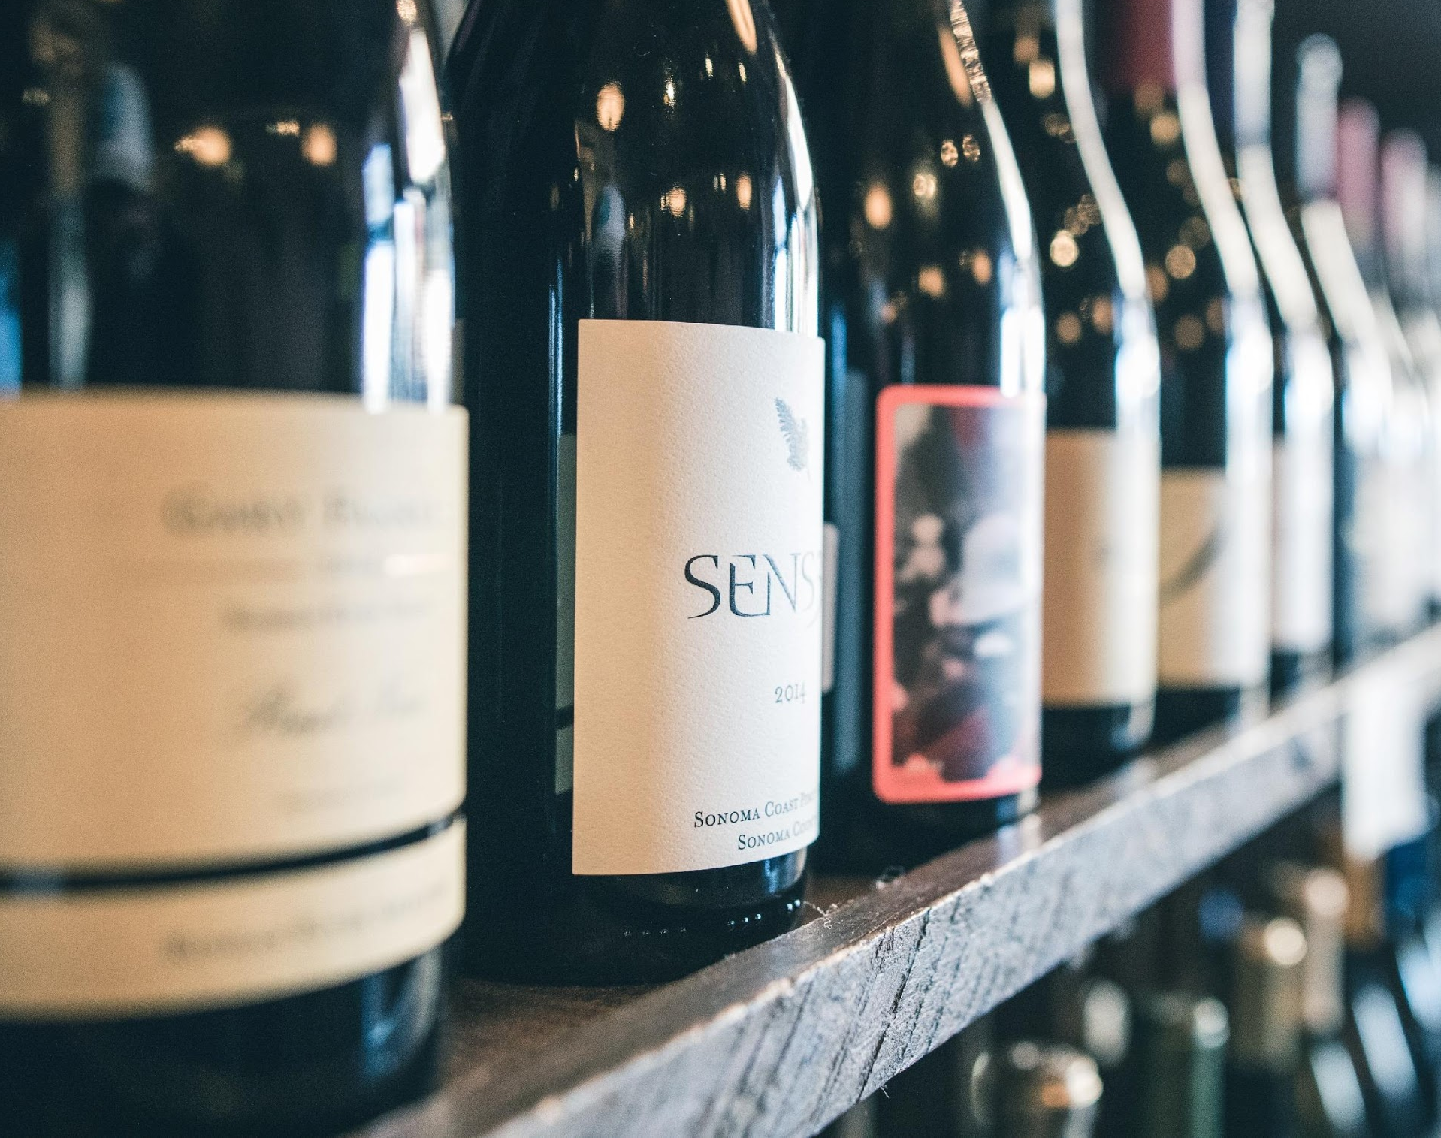
Vintly
The Winemaker’s Quality Predictor

Slide 2
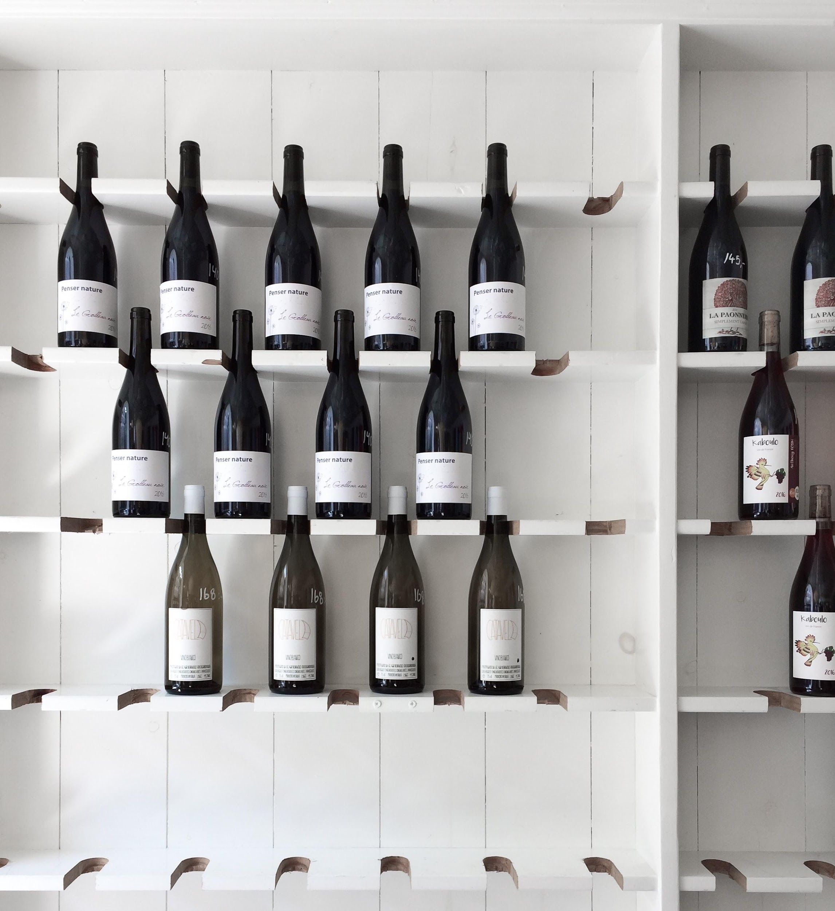
The Problem
How can winemakers determine whether their wine will be considered high or low quality? In order to
1. Inform Pricing
Without having a board of professional graders on hand, how can they make informed decisions?
2. Modify Production
Add more or less of a certain compound for a current harvest
Citric acid
Chlorides (salt)
Modify fermentation process for the future harvests
Ferment longer for less residual sugar
Expose to less oxygen to lower volatile acidity
Notes:
YEONJAEE

Slide 3
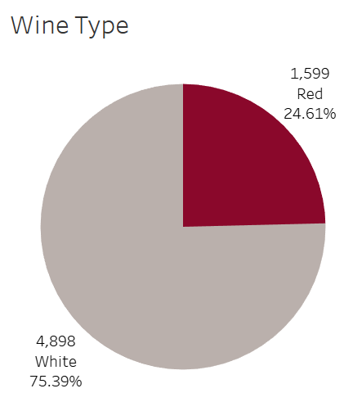
The Data
Over 6000 wines
11 physiochemical property inputs (Objective)
Fixed Acidity
Volatile acidity
Citric acid
Residual sugar
Chlorides
Free sulfur dioxide
Total sulfur dioxide
Density
pH
Sulphates
Alcohol
1 sensory output-based quality score 0-10 (Subjective)
By the courtesy of:
P. Cortez, A. Cerdeira, F. Almeida, T. Matos and J. Reis. Modeling wine preferences by data mining from physicochemical properties. In Decision Support Systems, Elsevier, 47(4):547-553. ISSN: 0167-9236.
Notes:
YEONJAE

Slide 4
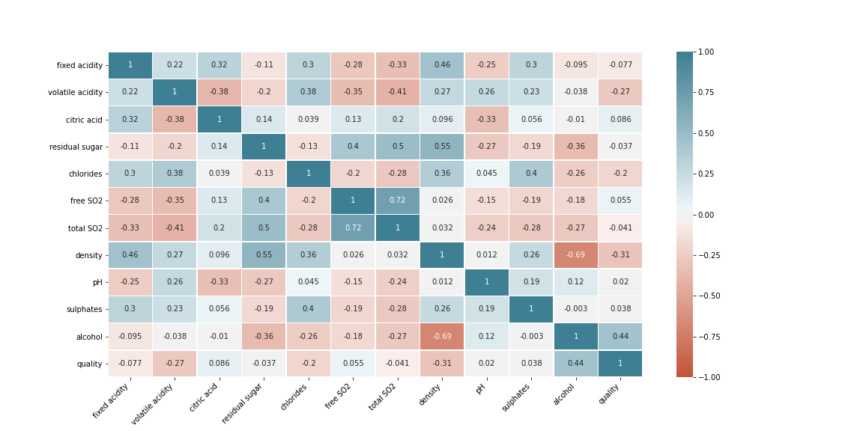
Correlation Matrix

Slide 5
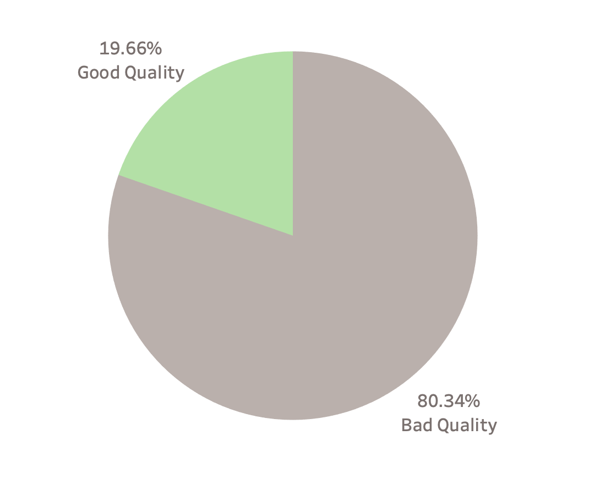
The Challenge
Classification!
Quality score was sensory based therefore individual linear scores were less informative than a binary classification.
Good wines are always hard to find and are the minority. Imbalanced distribution of wine qualities makes classification, difficult.
False positives present in grading make our clients lose reputation
False negatives make them lose money
It’s always the trade-off faced when we boost the classification to either have less false positives or false negatives.
Class Imbalance
Notes:
YEONJAE

Slide 6
The Solutions
We developed three models with three different metrics each to allow a winemaker to evaluate their business goals and select the one most suited to them.
Models:
Deep Learning
Logistic Regression
Scaled Vector Machine
Metrics:
Precision
Recall
Accuracy
Notes:
YEONJAE

Slide 7

Metrics
Accuracy
The simplest of metric, accuracy works well when there are equal number of samples belonging to each class.
For our dataset, accuracy would be inflated to favor the majority class, bad wines, correctly labelling them more often than good wine correctly.
Notes:
Patrick

Slide 8
Metrics
Precision
Recall
Also called Positive predictive value.
The ratio of correct positive predictions to the total predicted positives.
Precision is a good measure when the cost of False Positive is high.
If a Bad Quality wine is incorrectly classified as Good Quality,
Reputation is at stake.
Also called Sensitivity, Probability of Detection, True Positive Rate.
The ratio of correct positive predictions to the total positives examples.
Recall is a good measure when the cost of False Negative is high.
If a Good Quality wine is incorrectly classified Bad Quality,
Money is at stake.
Notes:
Patrick

Slide 9
False Negative vs False Positive
Falsely classifying a good wine as bad might result in losing money.
Falsely classifying a bad wine as good would hurt reputation. (Ultimately hurting a higher end brand that would result in overall loss of money).
Notes:
False negative means it should be positive but falsely saying it’s not. (“you’re not sick when actually you are”)
False positive means it should be negative but falsely saying it is. (“you’re sick when you are not”)

Slide 10
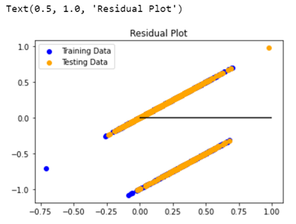
Multi-V Linear Model
Given that the outcome of our data was linear, on a basis of 0-10 in quality ranking, we initially tried a multivariate linear regression.
Quality was based on sensory input, we found that a multivariate linear model was not accurate, and determined that a logistic model of “good quality” vs “bad quality could be more effective.
With the knowledge that what is subjectively considered a “good” wine vs “bad” in terms of pricing, we created bins for for everything above average being classified as “good” and average or below classified as “bad”.
Notes:
MARK

Slide 11
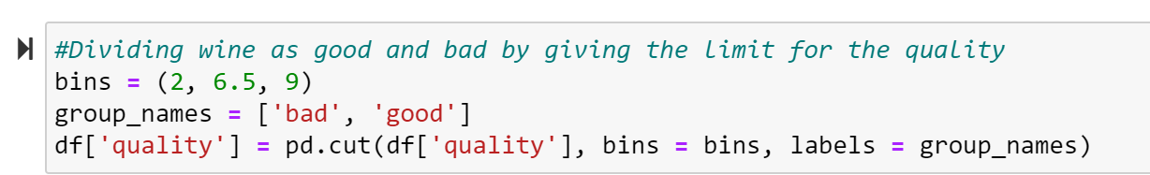
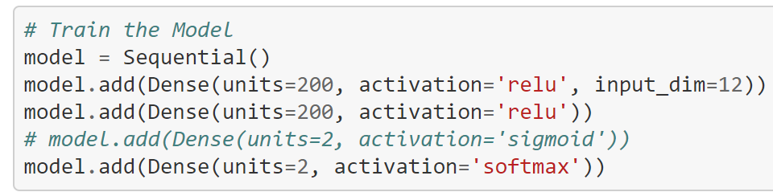
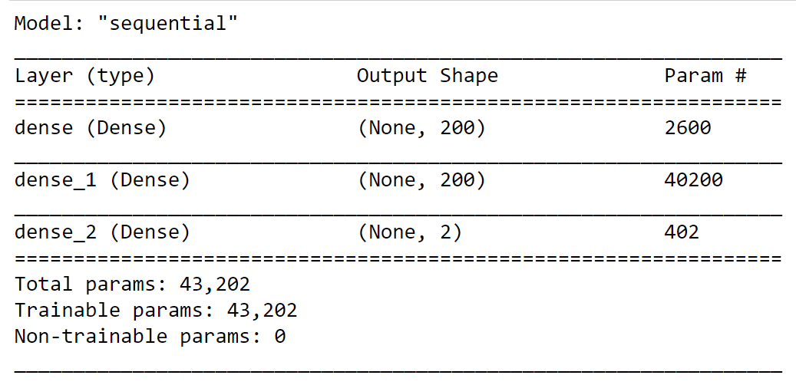
Deep Learning
Model Summary
Notes:
MARK

Slide 12
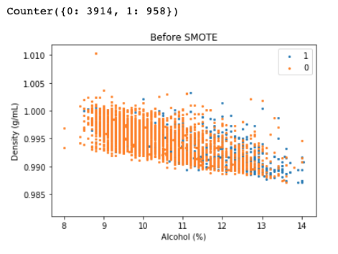
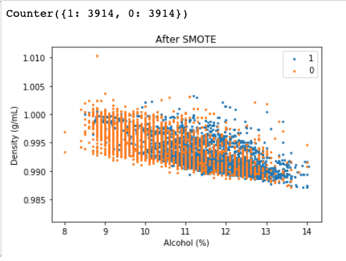
What is Smote?
Synthetic Minority Over-sampling Technique (SMOTE) is a machine learning algorithm that resolves class imbalance problem, such as when one class in the training set dominates the other.
Our data before SMOTE:
●958 Good Quality Wines (minority)
●3914 Bad Quality Wines (majority)
Our data after SMOTE:
●3914 Good Quality Wines (minority)
●3914 Bad Quality Wines (majority)
SMOTE imagines new, synthetic minority instances to balance the imbalance out.
Notes:
Patrick

Slide 13
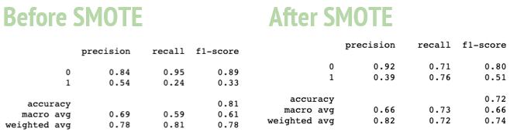
Logistic Regression
Overall accuracy is slightly worse after SMOTE, however it was originally weighted to favor correct classification of bad wines and incorrect classification of good wines, due to the imbalance of samples in each class.
After SMOTE, good wine recall is dramatically improved, making it a better model for those more interested in not losing money by accidentally classifying a good wine as bad, as opposed to not hurting their reputation by classifying a bad wine as good.
SMOTE improves the overall accuracy of the Logistic Regression model by identifying the quality of wines, with improved accuracy in identifying the good wines as good = Better pricing potential
Notes:
Patrick

Slide 14
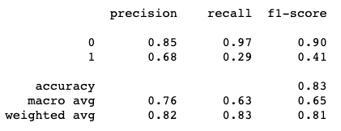
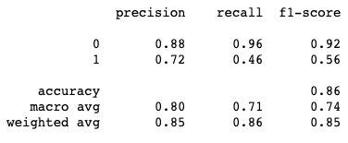
Support Vector Machine
Before GridCV
SVM address class imbalance by assigning different weights to positive and negative instances.
GridCV is part of the sklearn library, that automates the process of performing hyper parameter tuning in order to determine the optimal values for a given model.
After GridCV
Notes:
Essentially you weigh the samples so that the sum of the weights for the positives will be equal to that of the negatives.

Slide 15
Confusion Matrix
Model Prediction
Bad Quality
(0)
Good Quality (1)
Bad Quality
(0)
True Negative
Correctly predicted
Bad Quality
False Positive
Incorrectly predicted
Good Quality
Actual Wine Quality
Good Quality (1)
False Negative
Incorrectly predicted
Bad Quality
True Positive
Correctly predicted
Good Quality

Slide 16
Testing Results
Deep Learning (n=1,625) | Predicted: (Bad Quality) | Predicted: (Good Quality)
Actual: (Bad Quality) | 1,244 (77%) | 62 (3%)
Actual: (Good Quality) | 211 (13%) | 108 (7%)
SVM (n=1,625) | Predicted: (Bad Quality) | Predicted: (Good Quality)
Actual: (Bad Quality) | 1,269 (78%) | 37 (2%)
Actual: (Good Quality) | 173 (11%) | 146 (9%)
Logistic Regression (SMOTE) (n=1,625) | Predicted: (Bad Quality) | Predicted: (Good Quality)
Actual: (Bad Quality) | 924 (57%) | 382 (23%)
Actual: (Good Quality) | 76 (5%) | 243 (15%)

Slide 17
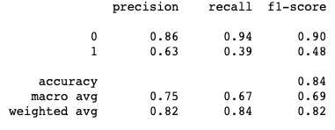
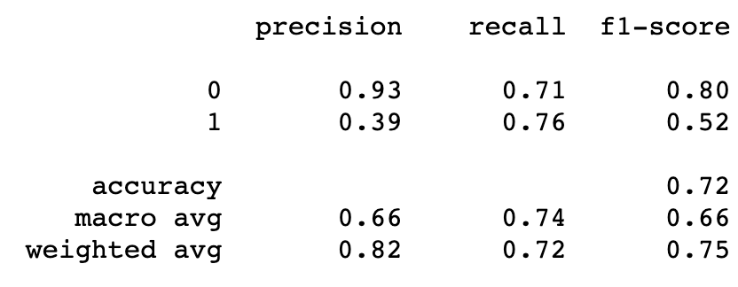
SVM with GridCV
SVM had highest accuracy, (the best balance of Recall and Precision) and the best Precision. This model is better for those concerned with balance or reputation, (don’t want to sell bad wine labeled as good)
Logistic with SMOTE had the best Recall, but lowest Precision, better for preventing labeling of good wine as bad, therefore preventing loss of money.
Deep Learning
Logistic with SMOTE
REPUTATION VS
PRICE-RISK BENEFITS

Slide 18

QUESTIONS

